Slide 1

RESEARCH
METHODOLOGY
DR.SHRUTHI ESHWAR
DEPARTMENT OF PUBLIC HEALTH DENTISTRY
K.L.E SOCIETY’S INSTITUTE OF DENTAL SCIENCES
BANGALORE

Slide 2

Research is to see what everybody else has seen, and to think nobody else has thought
- Albert Szent Gyorgyi
Research is to see what everybody else has seen, and to think nobody else has thought
- Albert Szent Gyorgyi

Slide 3

CONTENT
Introduction to research and research methodology.
Identification & formulation of research problem
Hypothesis formulation.
Research designs
Sampling & sampling strategy.
Data collection methods.
Ethics in research.
Writing a research protocol.

Slide 4

Starting Trouble
What research
Why research

Slide 5
Set Induction
ABSTRACT THINKING
CRITICAL THINKING
SYSTEMATIC THINKING
COMMUNICATIVE THINKING

Slide 6

Definition
“Research is a quest for knowledge through diligent search or investigation or experimentation aimed at discovery and interpretation of new knowledge.”
“Science of studying how research is done systematically.”

Slide 7

Research methodology
Systematic study
Defining a problem
Hypothesis formulation
Collection & analysis of data
Deductions & conclusion.

Slide 8

Objectives of Research
Insight towards a topic
To verify & test facts
To analyse an event/ process/phenomenon
To identify cause & effect relationship
To find solutions to scientific/ non scientific problems.

Slide 9

Significance of research methodology
Inculcates scientific & inductive thinking
Promotes development of logical habit of thinking
Study of cause & effect relationship
Helps in policies, regulations which are based on the results of research.
Decision making

Slide 10
Types of Research
Types of Research
From the view point of
Application
Objectives
Type of Information Sought
Exploratory
Research
Pure
Research
Quantitative
Research
Descriptive
Research
Applied
Research
Qualitative
Research
Correlation
Research
Explanatory
Research

Slide 11
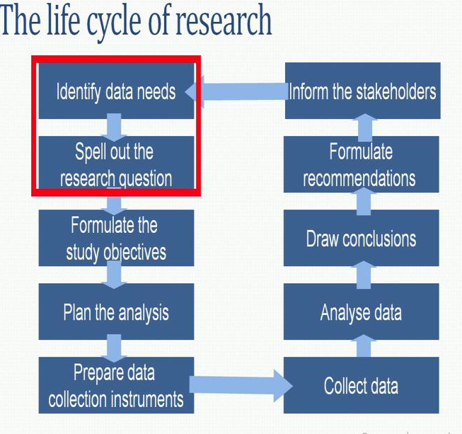
Research Process

Slide 12
Stages in Research Process
Conceptual phase ( problem, hypothesis, variables, literature search, scope & framework)
Planning /design phase ( methods, design, sample, instrumentation)
Empirical/implementation phase ( data collection, data encoding, presentation)
Analytical phase ( data analysis & interpretation)
Dissemination/utilization phase ( publication)

Slide 13
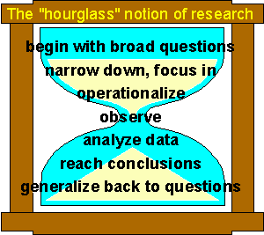
Structure of research – Hour Glass Analogy

Slide 14
Research process
Idea / uncertainty
Research problem
Research question
Objectives
Hypothesis

Slide 15
Research problem
Research problem : difficulty either of theoretical/practical character which a researcher identifies as the context for doing study.
Research question : Research question is an uncertainty about something in the population that the investigator wants to resolve by making measurements in the study population.

Slide 16
Sources of research problem
Reading
Academic experience
Literature survey
Tracking research trends & emphasis
Projecting future technology based on existing knowledge
Exposure to field situation
Experience survey
Brainstorm for ideas.

Slide 17
Selection of problem
Internal criteria | External criteria
Researchers interest & competence Resources Check on – what is my research Why to do research Who are research participants | Research ability Relevancy Usefulness Novelty Practicability Feasibility Ethical & political acceptability by subjects/ authority .

Slide 18
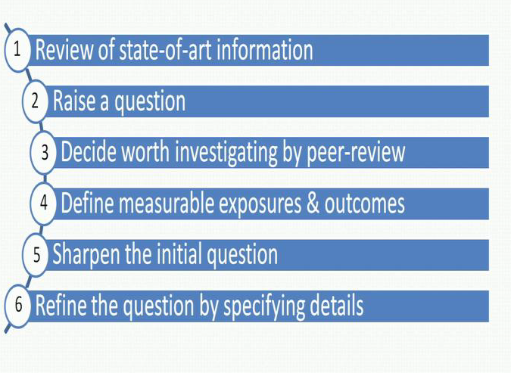
Steps in conceiving a research question

Slide 19
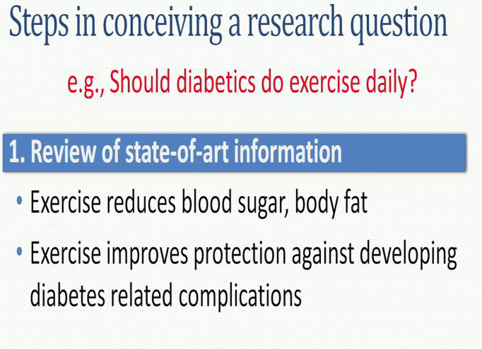
Steps in conceiving research question
Q) Should Diabetics do exercise daily ?

Slide 20
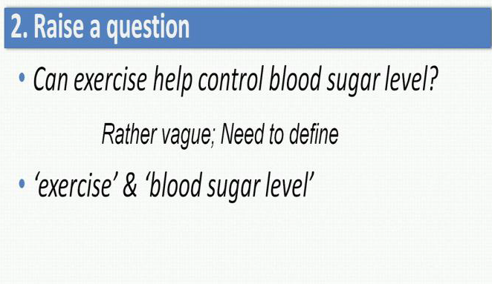
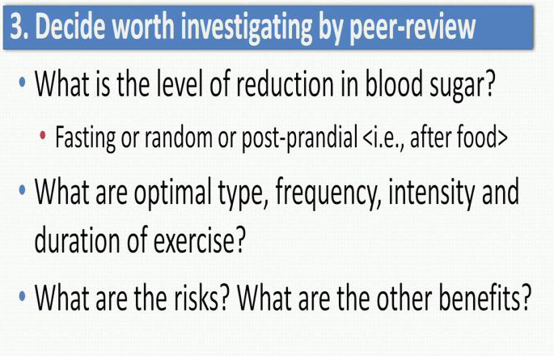
Steps in conceiving research question

Slide 21
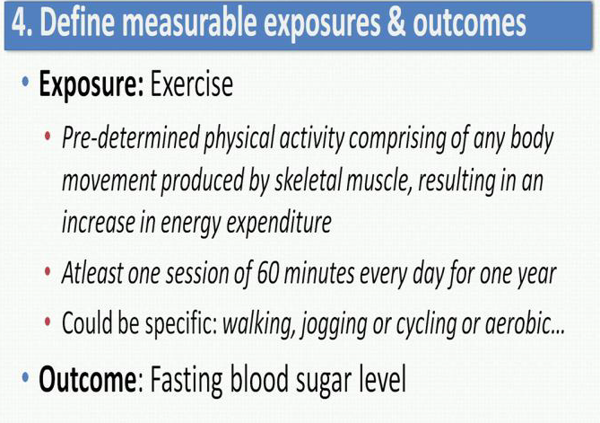
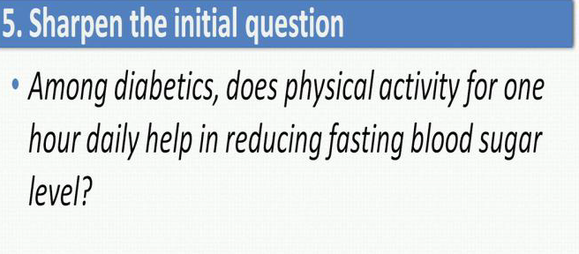
Steps in conceiving research question

Slide 22
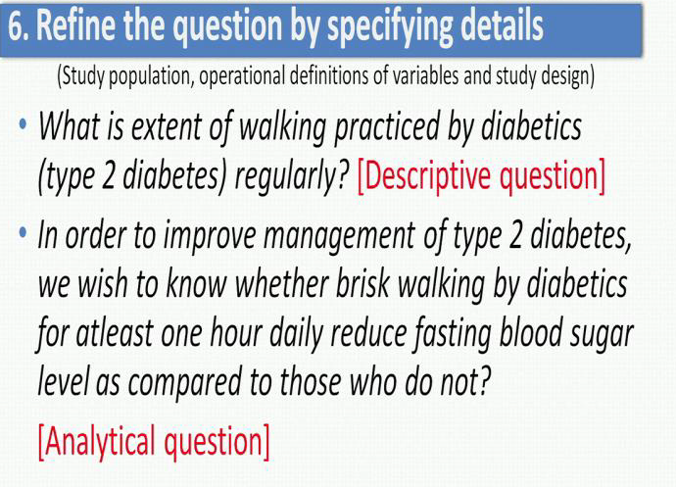
Steps in conceiving research question

Slide 23
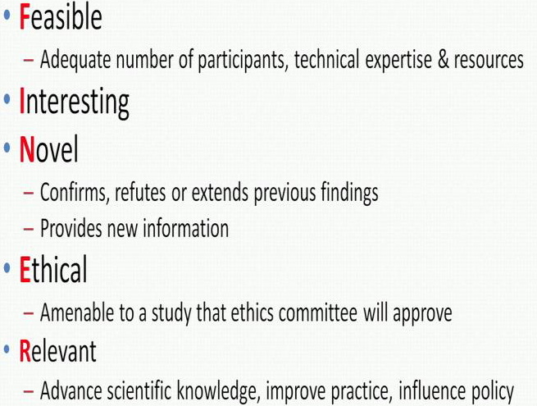
Good research question

Slide 24
Do’s & Don'ts in problem selection
Do not borrow idea
Address right question
Objective, flexible &uncommitted
Appropriate methodology
Don’t overlook the interaction
Identify the gaps.

Slide 25
Research hypothesis
Hypothesis is an assumption
Specific version of the research question that summarizes the main elements of the study that establishes the basis for statistical test of significance.
Elements – sample , exposure and outcome.

Slide 26

Types of hypothesis
Directional vs. Non-directional
Research vs. Null
Simple vs. Complex
Association vs. Causal

Slide 27
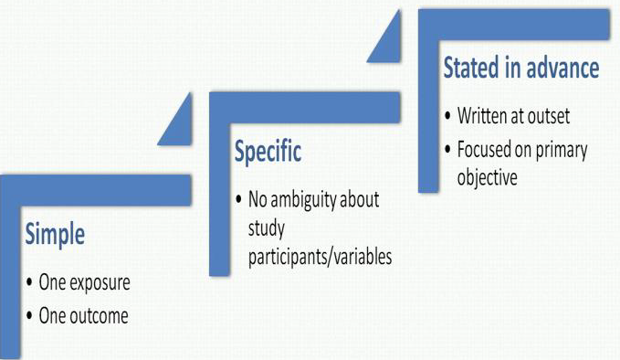
Characteristics of good hypothesis

Slide 28
Research question – objectives
Frame scientific/epidemiological terms
Take the question in a few limited axis
Write in scientific/epidemiological language
Make use of not more than one verb for each
Sort as a primary and secondary
Be clear about the type of question
Descriptive questions – measuring hypothesis
Analytical questions – Testing the hypothesis

Slide 29

Research question – objectives
Research Question:
In order to Improve the management of type 2 diabetes, we wish to know whether brisk walking by diabetics, at least 1 hour daily will reduce the fasting blood sugar level when compared to them who do not ?
Primary Objective:
Determine the effect of brisk walking for at least one hour daily on fasting sugar levels of patients with type 2 diabetes compared those who do not

Slide 30

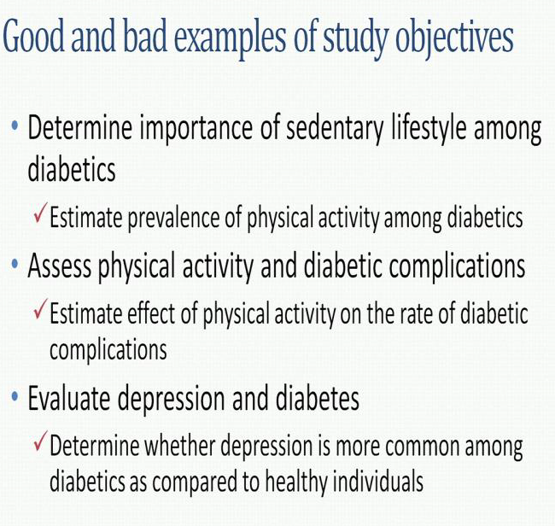
Research question – objectives

Slide 31

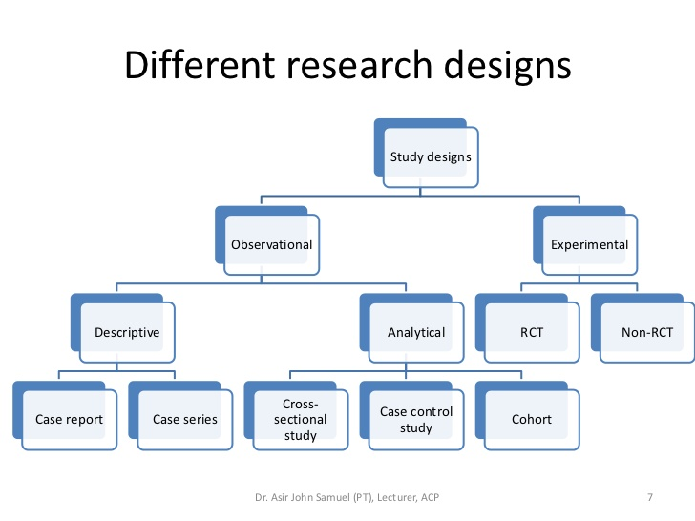
Overview of research designs
Apt research methods are the road for success in research Different types of study designs

Slide 32

Descriptive study design
First step in studying the disease / condition
Describes the disease according to time, place and person.
Helps in identifying the etiological factors
Helps to frame the hypothesis.
Case report
Case series report
Cross sectional survey
Longitudinal survey
Clinical audit
Economic analysis

Slide 33

Steps in conducting descriptive study
1. Define the study population
2. Give an operational definition for the disease under study
3. Describe the disease in terms of time/place/person
4. Measure the disease (Cross sectional/Longitudinal)
5. Compare with known indices
6. Generate hypothesis

Slide 34
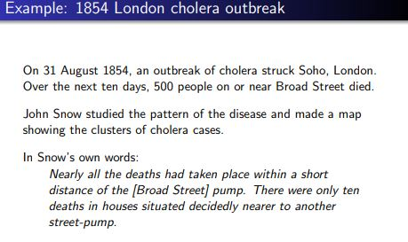
Research problem example – Descriptive Study

Slide 35

Analytical study designs
Second major type of epidemiological study designs
Occupy an intermediate position in the ‘Hierarchy of Evidence’
Association between a suspected factor (exposure) and specific outcome is identified
Case Control study
2. Cohort study

Slide 36
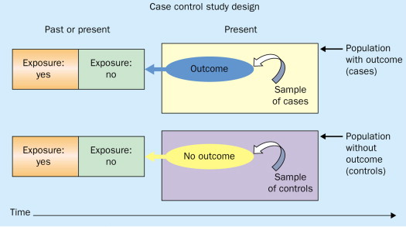
Case control study design
Retrospective study
Cause – effect
Cases and controls
Tests the hypothesis
Measure – odds ratio.

Slide 37
Steps in case control study
PROCESS
Selection of cases and controls
Matching
Measurement of exposure
Analysis and Interpretation
ANALYSIS
Exposure Rate
Odds Ratio

Slide 38
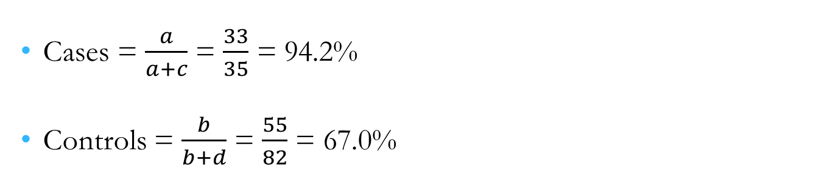
Exposure Rate
Suspected or risk factors | Cases (with lung cancer) | Controls (without lung cancer) | Total
Smokers | 33 a | 55 b | 88 (a+b)
Non smokers | 2 c | 27 d | 29 (c+d)
Total | 35 (a+c) | 82 (b+d) | n = a+b+c+d = 117

Slide 39
Odds ratio or cross product ratio
It is a measure of the strength of association between risk factor and outcome.
It is based on three assumptions:
  Disease being investigated is relatively rare.
  Cases must be representative of those with the disease.
  Controls must be representative of those without the disease.
  In the above example OD = ad/bc
  OD = 33*27/55*2
  OD = 8.1

Slide 40
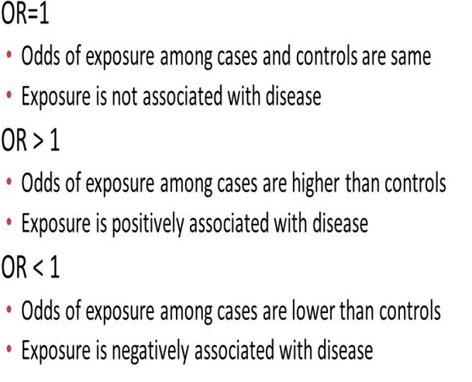
Interpretation of odds ratio

Slide 41
Bias in case control study
Selection bias
  Prevalence incidence bias
  Admission rate bias
  Information Bias – 1. Memory or recall bias
  2. Telescopic bias
  3. Interviewer’s bias
  Bias due to confounding

Slide 42
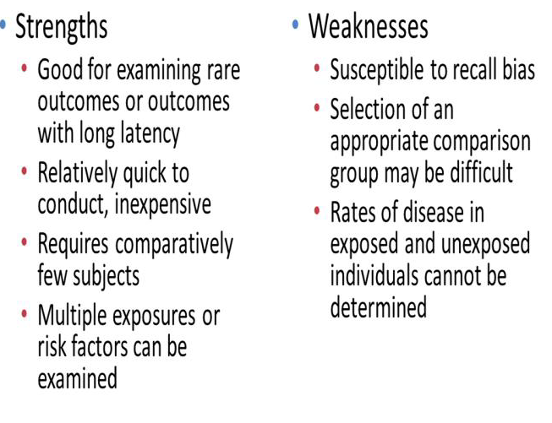
Case-Control Study

Slide 43
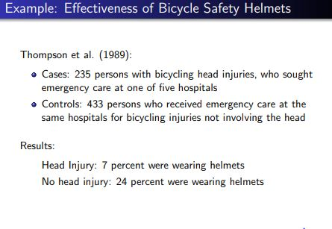
Research problem example – Case -Control Study

Slide 44

Cohort study
Prospective study
COHORT - Specific character
Exposure is identified prior to the study
Follow up study

Slide 45
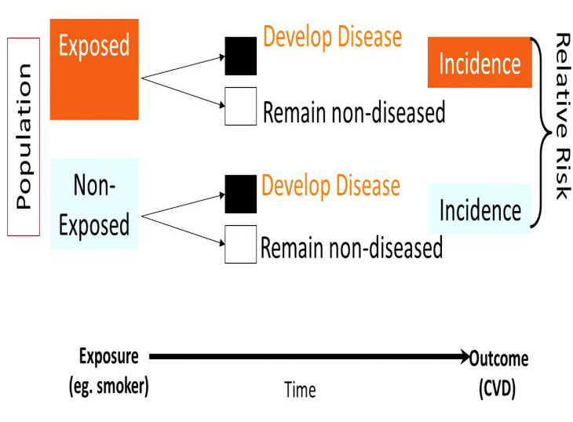
Cohort study - Design

Slide 46
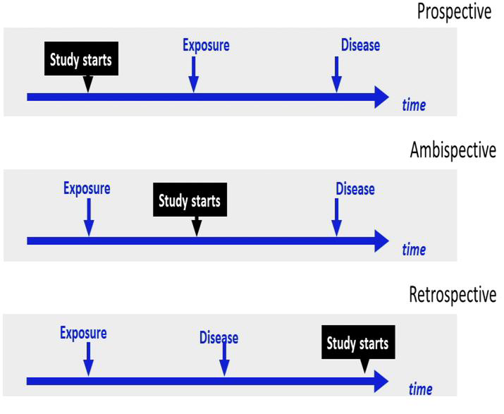
Cohort study - Design

Slide 47
Steps in cohort study
PROCEDURE
Selection of study population
Obtaining Data on exposure
Selection of comparison group
Follow up
Analysis
ANALYSIS
Relative Risk
Attributable Risk
Population attributable Risk

Slide 48
Cigarette smoking | Developed lung cancer | Did not develop lung cancer | Total
Yes | 70 (a) | 6930 (b) | 7000 (a+b)
No | 3 (c) | 2997 (d) | 3000 (c+d)
Incidence rates
    Can be determined directly.
    Among smokers = 70/7000 = 10 per 1000
    Among non smokers = 3/3000 = 1 per 1000
    Statistical significance: P < 0.001

Slide 49

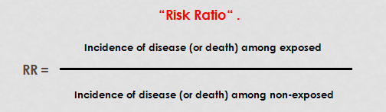
Cohort - Analysis
  Relative risk (RR)
    It is ratio of the incidence of the disease among exposed and the incidence among non-exposed.

Slide 50
Cohort - Analysis
    The larger the RR, the greater the “strength” of the association between suspected factor and the disease.
    However, risk does not necessarily imply causation.

Slide 51
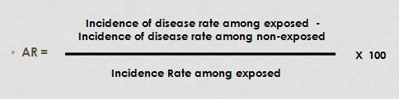
Cohort - Analysis
  Attributable risk
    It is the difference in incidence rates of disease between an exposed and non-exposed group.
    It is also known as “risk difference”.
    It is expressed as a per cent.

Slide 52
Cohort - Analysis
    Population Attributable Risk:
    incidence of the disease in total population minus the incidence of disease among those who were not exposed to the suspected causal factor.

Slide 53
Bias in cohort study
Bias in assessment of outcome
Information bias
Bias from non response and losses to follow up
Analytic bias

Slide 54
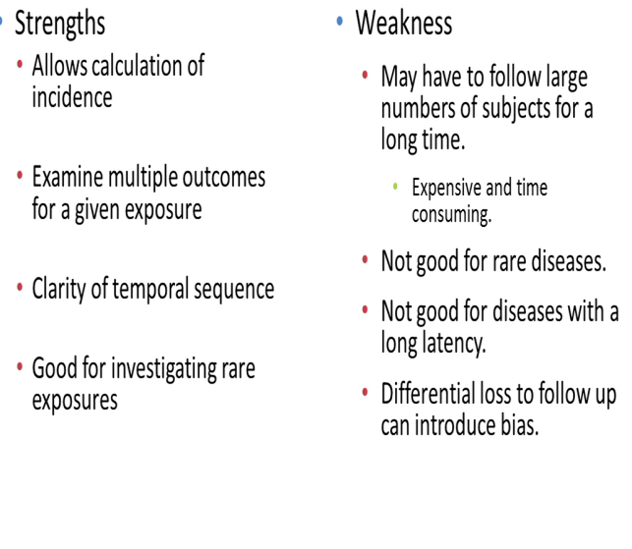
Cohort study

Slide 55
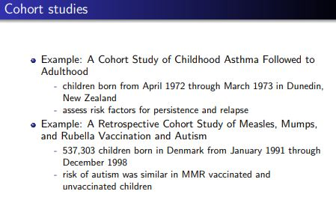
Research problem example – Cohort Study

Slide 56
Experimental study design
Helps to test the hypothesis and prove causal relation.
where the exposure is manipulated by the investigator and a classical example of this is clinical trials.
Higher level in evidence
1.Concurrent parallel design
2.Cross over design
3.Split mouth design
4.Latin square design
5.Factorial design
6.Sequential design

Slide 57
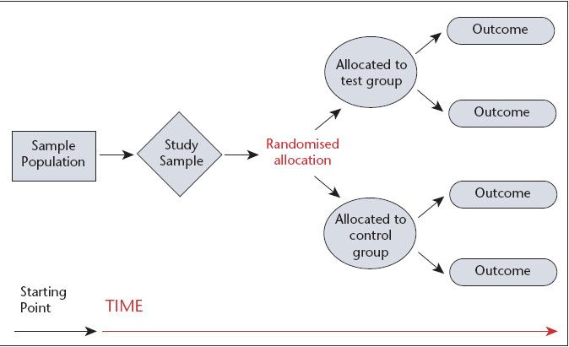
RCT – Concurrent parallel

Slide 58
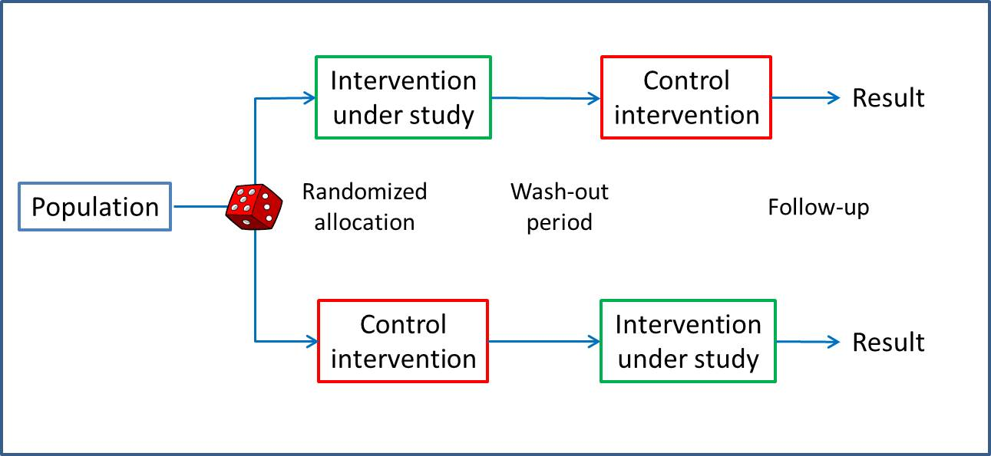
Crossover study design

Slide 59
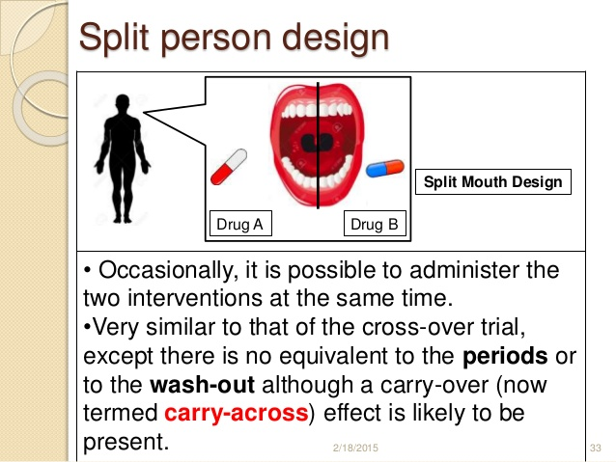
Split mouth trial

Slide 60
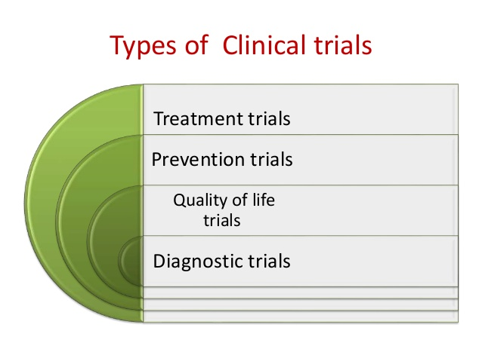
Clinical trials
A design to find out efficacy of drugs or clinical procedures
Randomized double blind trial.
Higher evidence.

Slide 61
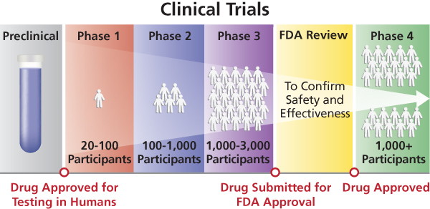
Clinical trials phases

Slide 62
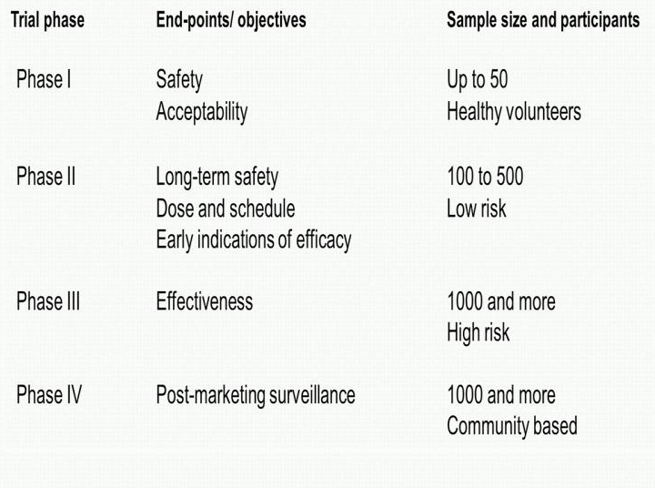
Clinical trials Phases

Slide 63

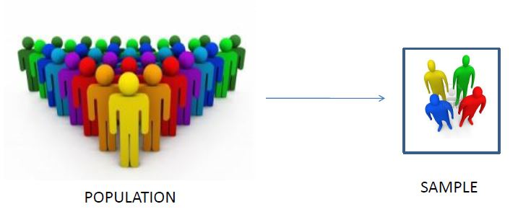
Sampling
Procedure by which some members of a given population are selected as representatives of the entire population.
Sample – Subset of target population
Sampling unit - Each member of the population is called as sampling unit.
Sampling frame - A list containing all sampling units
.

Slide 64
Sampling
WHY SAMPLING
Cost effective
Manage resources
Results generalizable
SAMPLING CONCEPT
Whole Population
Accessible population
Sample

Slide 65

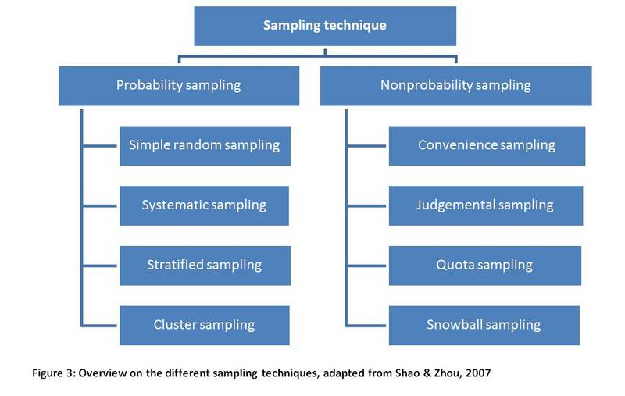
Sampling process
Identify the population of interest
Specify the sampling frame
Select a suitable sampling technique
Determine the sample size
Implement the plan

Slide 66

Sampling errors
Sampling error
Non sampling error –
1. Poor sampling methods
2. Questionnaire or measurement error
3. Behavioural effects

Slide 67
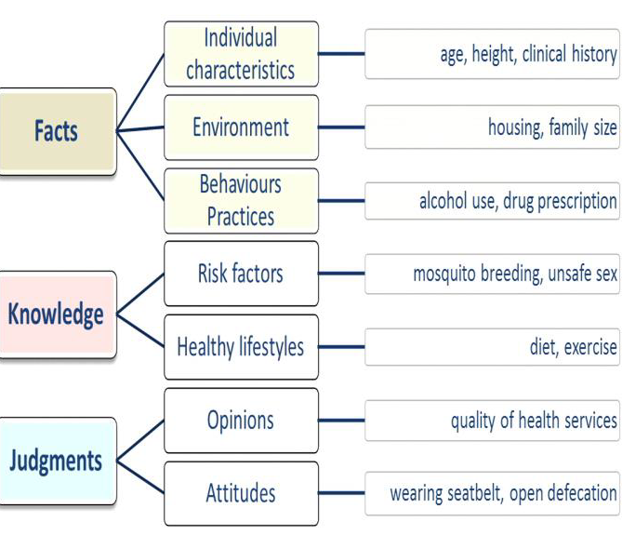
Methods of data collection

Slide 68
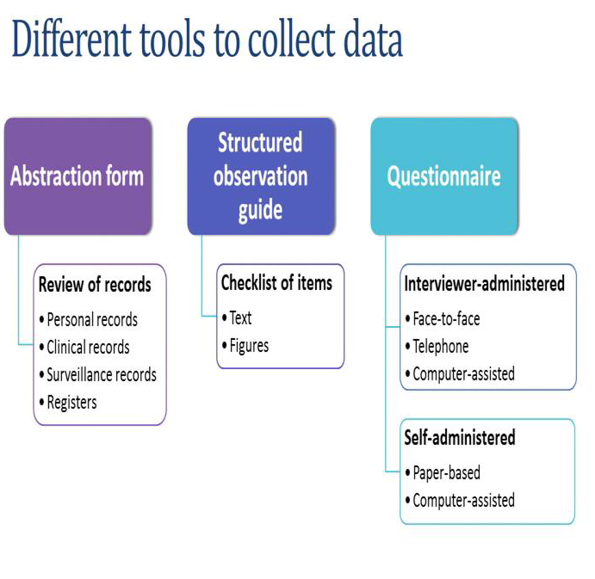
Tools of data collection

Slide 69







Types of Questionnaire
Unstructured
Structured
Semi-structured
Open Ended
Close Ended
Mixed
Completely
Unstructured
Dichotomous (Two
category)
Matrix
Contingency
Thematic Perception
Test
Word Associate
Multiple Choice
Sentence, Story or
Picture Completion
Scale Questions

Slide 70
Formulating questions
Simple words
Short & precise questions
Avoid negatives & double negatives
Ask one question at a time
Be specific
Avoid hints

Slide 71
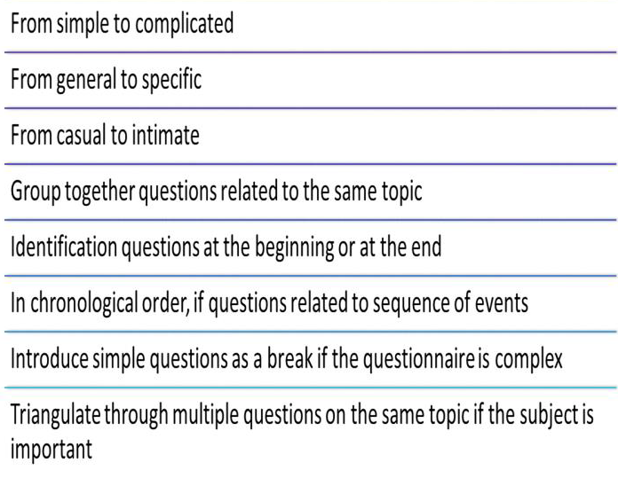
Order of questions

Slide 72
Ethics in biomedical research
Always important to remember that ethical foundation is considered as implicit for conducting any kind of research and it is applicable not only to health research, but to any research in general.

Slide 73
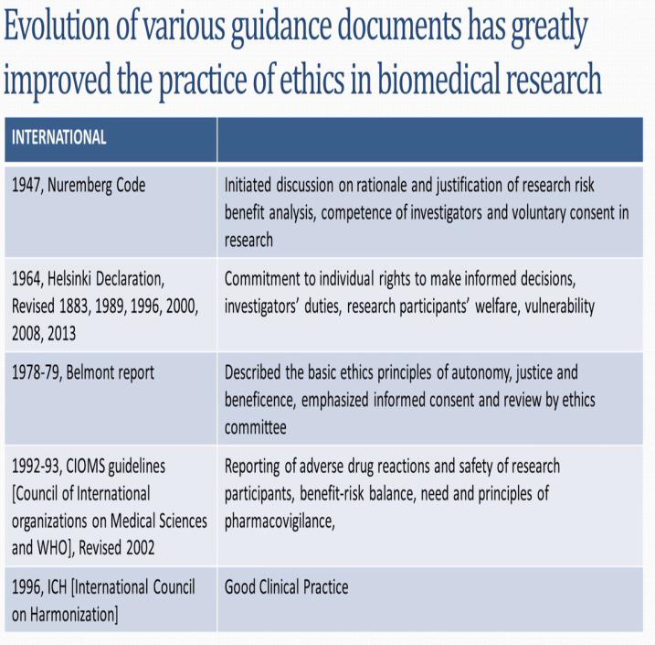
Evolution of various guidance documents has greatly improved the practice of ethics in biomedical research

Slide 74
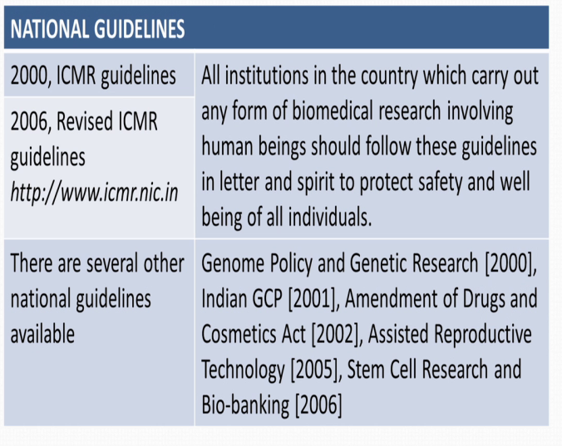
Evolution of various guidance documents has greatly improved the practice of ethics in biomedical research

Slide 75

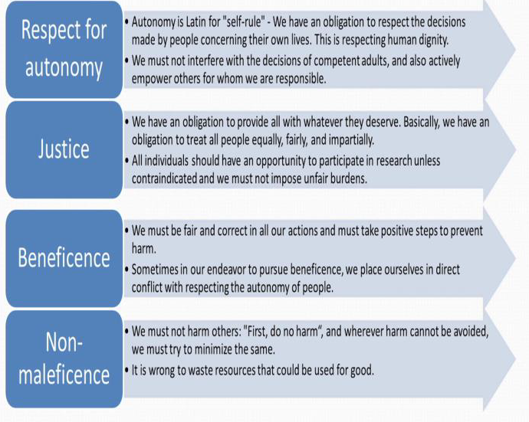
Ethical principles

Slide 76
Informed consent
Systematic way in which the proposed research is explained to the potential participants in a systematic step by step process and the potential participants empowered to take an informed decision to participate in the research study.

Slide 77
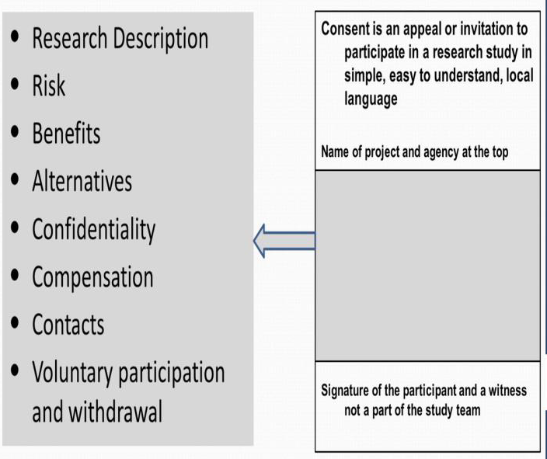
Informed consent document

Slide 78
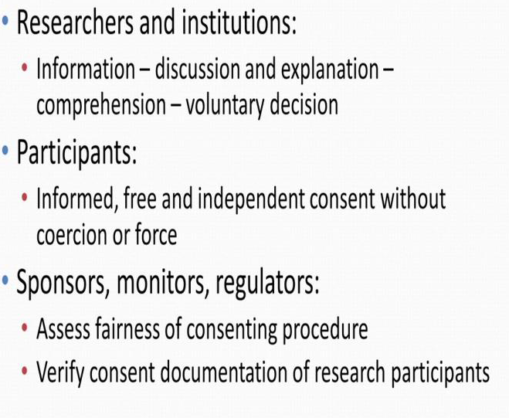
Stakeholders in informed consent process

Slide 79
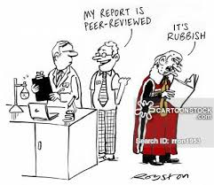
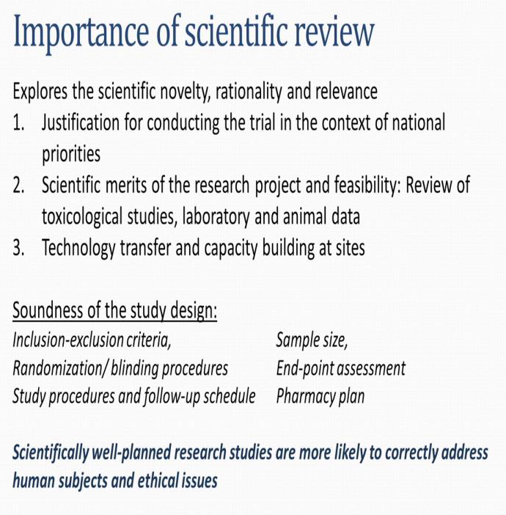
Importance of scientific review

Slide 80

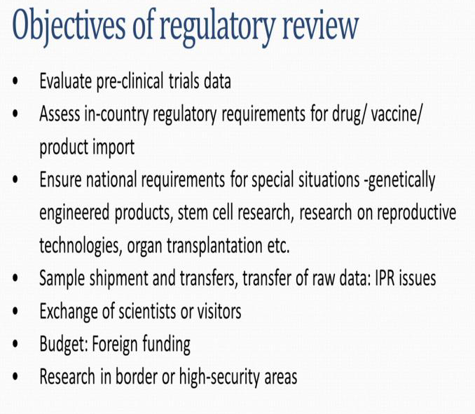
Objectives of regulatory review

Slide 81
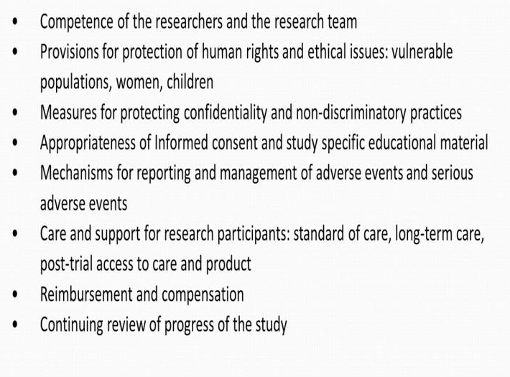

Ethical issues to be addressed in research

Slide 82
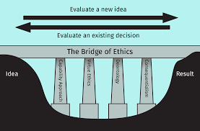
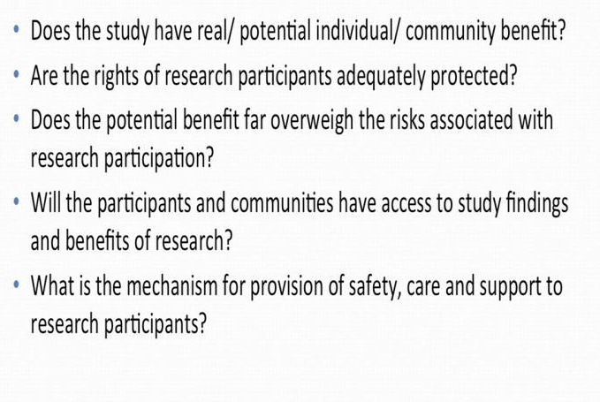
Responsibilities of IEC/IRB

Slide 83

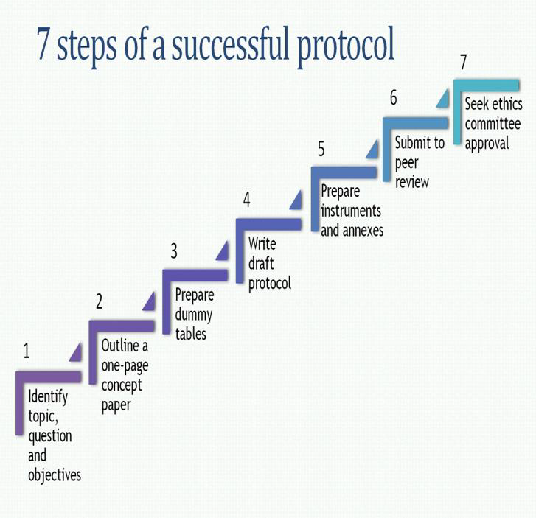

Protocol writing

Slide 84

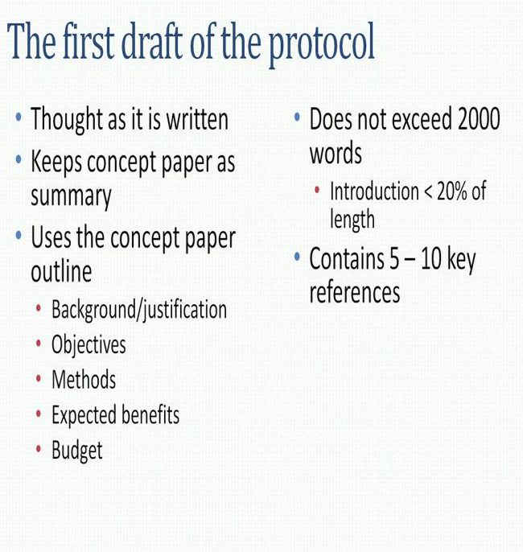
Protocol writing

Slide 85
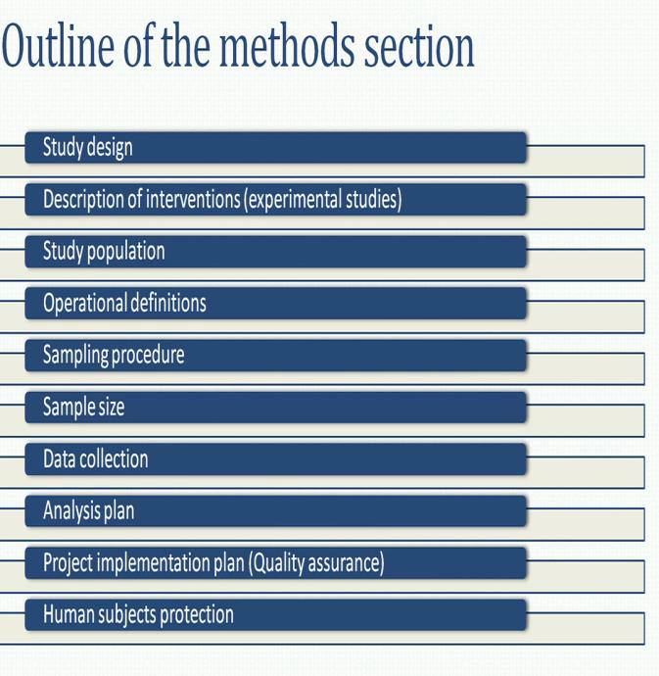
Protocol writing- Outline of the methods section

Slide 86


Study design paragraph

Slide 87
Protocol writing- Outline of the methods section

Slide 88

Description of the intervention

Slide 89
Protocol writing- Outline of the methods section

Slide 90

Study population paragraph

Slide 91
Protocol writing- Outline of the methods section

Slide 92

Operational definitions paragraph

Slide 93
Protocol writing- Outline of the methods section

Slide 94

Sampling procedure paragraph

Slide 95
Protocol writing- Outline of the methods section

Slide 96

Sample size paragraph

Slide 97
Protocol writing- Outline of the methods section

Slide 98

Data collection paragraph

Slide 99
Protocol writing- Outline of the methods section

Slide 100

The analysis plan paragraph

Slide 101
Protocol writing- Outline of the methods section

Slide 102

Project implementation plan paragraph

Slide 103
Protocol writing- Outline of the methods section

Slide 104

Human subjects protection paragraph

Slide 105



Annexure

Slide 106


Finalizing the protocol

Slide 107
Frequently asked Questions (FAQs)
Introduction to research and research methodology.
Research In Dentistry.
Applications of research in dentistry ( expected marks - 7 marks)
Outline :
1.Define Research methodology
2. Objectives , Significance, Types of Research
3. Criteria of Good Research
4. Research process
5. Defining a research problem
6. How to proceed the research process
7. Public Health significance of research
8. Conclusion
9. References

Slide 108
Frequently asked Questions (FAQs)
II. Hypothesis (7 Marks)
1.Define Hypothesis
2.Types of Hypothesis
3.Need of Hypothesis in research process
Outline:
Definition, classification of hypothesis – Directional/Non-directional
2.Need of Hypothesis :
a. Formulating objectives
b. Aids in choosing study design
c. Analysis, Drawing conclusion
d. Helps in acceptance/rejection of study findings
e. Deciding upon statistical test
3. Conclusion
4. References

Slide 109
Frequently asked Questions (FAQs)
III. Research Designs (20 Marks)
1. Enumerate a Life cycle of Research
2. Enumerate and explain different types of study designs
OUTLINE :
Descriptive | Analytical | Experimental
Introduction –Definition Define – study population Steps in conduction DE Formulation of an aetiological hypothesis Historical studies – Shoe leather survey Uses of Descriptive Epidemiology Conclusion References | Introduction – Types – Case control, Cohort, Ecological studies Steps in conducting Analytical and ecological studies Analysis – OR,RR,AR,PAR BIAS Variants – case control, cohort study Uses of Analytical Epidemiology Historical studies – Framingham heart study, Doll & Hill, Oral Contraceptives and health Conclusion References | Randomized control trial or clinical trials Steps in RCT Study designs Types of randomized control trials Blinding ,Bias Field & Community trials Non –randomized trials Clinical registration of trials Protocols for reporting clinical trials Conclusion References

Slide 110
Frequently asked Questions (FAQs)
IV. Errors/Bais (7 marks)
1.Define Error
2.Types of Error
3. Define Bias
Outline:
Introduction – define error
2. Types of Error :
Sampling error
Non-sampling error
  1. Missing data
    Coverage error
    Non-response error
  2. Measurement error
    Response error
    Processing (coding, data entry) error
3. Assessment and correction of Error
4. Conclusion
5. References

Slide 111
Frequently asked Questions (FAQs)
V. Sampling Technique ( 7 marks)
Define sampling, enumerate various terms under sampling.
Enumerate types of sampling technique and explain each with example
OUTLINE :
Definition – Sample, Sample frame, sample, unit, sample size,, sampling techniques.
3. Ideal requirements , Merits & demerits of each
4. Determining Sample Size
5. General principles of determining sample size
6. Sampling & Non-sampling errors
7. Conclusion
8. References

Slide 112
Frequently asked Questions (FAQs)
V. Methods Of Data Collection (7 Marks)
What is data and mention its types
Importance of Data collection in research
Methods of Data Collection
OUTLINE:
Introduction
2. Definition of data, methods of data collection- Review method, Self-administered, questionnaire , telephonic, mailing
3. Uses of Data
4. Standardization & calibration
4. Conclusion
5. References

Slide 113
Frequently asked Questions (FAQs)
V. Ethics (7 marks)
Define Ethics and explain the committees in regulating ethical principles.
OUTLINE :
Introduction
Definition of ethics
Ethical principles in dentistry
Informed consent
Objectives of ethics in research methodology
Regulatory bodies of ethics - Research
Conclusion
Reference

Slide 114


